Slide 1


Electricity Consumption
By Jonah Zembower, Ben Nicholson, Stanislav Chernyshov
Notes:
We are presenting an in-depth analysis of electricity consumption patterns. The goal is to understand trends, seasonality, and other factors that influence electricity usage over time. Our team, consisting of Jonah Zembower, Ben Nicholson, and Stanislav Chernyshov, has utilized advanced statistical methods to decompose the dataset, identify significant patterns, and create ARIMA and SARIMA models.

Slide 2
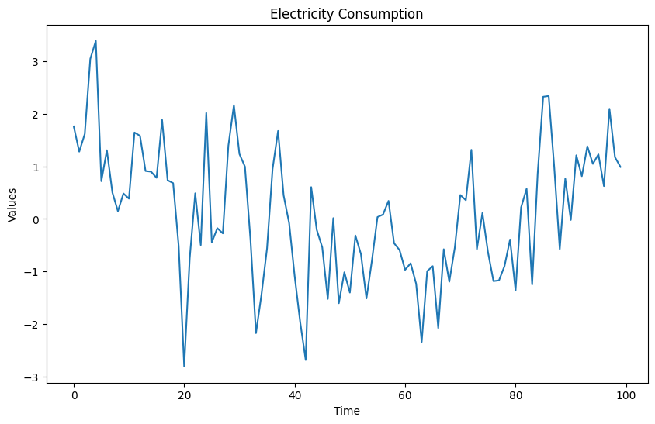
Viewing the Data
We see that there is a downward trend over the specific instances and then an increase again
Notes:
Our initial observations from the dataset indicate a fluctuating trend in electricity consumption with periods of decline followed by increases. This slide sets the stage for a more detailed analysis of these patterns, considering different time intervals and decompositions to understand underlying trends.

Slide 3
Weekly vs. Monthly Time Interval
There is no given time in the data
What is a reasonable guess?
Notes:
There was no given time for the data. We are looking to see what a reasonable guess would be. It wouldn’t be a yearly measurement because the amount of electricity that is consumed now would trump the amount consumed 100 years ago. So, it is between a weekly and monthly basis. We will progress with decomposing the dataset using a weekly or monthly basis. Looking at the seasonality pattern should be able to represent real world situations.

Slide 4
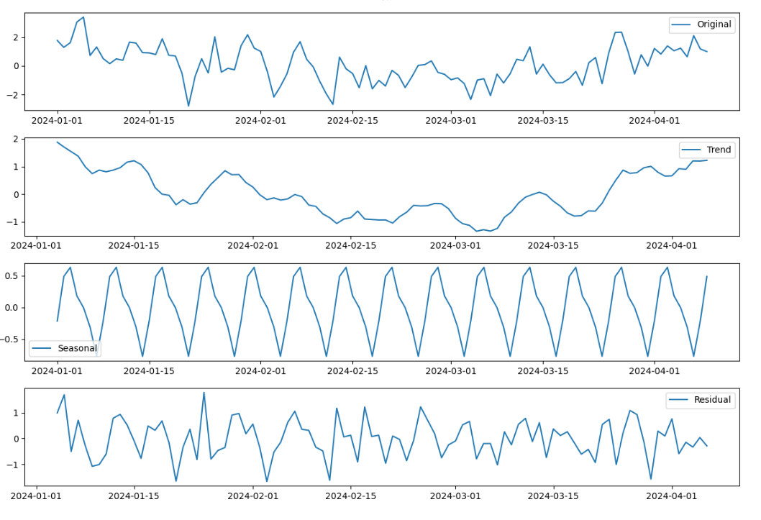
Weekly Seasonality Decomposition
Notes:
Trend- there is no overall change in average values in the time series
Cycles - There is a downturn during the beginning of February which continues until the middle of March before returning to as seen at the start of the year. This could be due to the nicer weather that takes place during February and March that does not require A/C or a heater. Where as in January you might be using a heater to come the house warm while the AC might be turned as you head into April due to warmer temperatures.
Seasonality - There is a constant seasonality which has a period of peaks with a downturn which is going by a quick increase to takes place within the weekly season
Residual - The residual as a constant mean around 0 with white noise

Slide 5
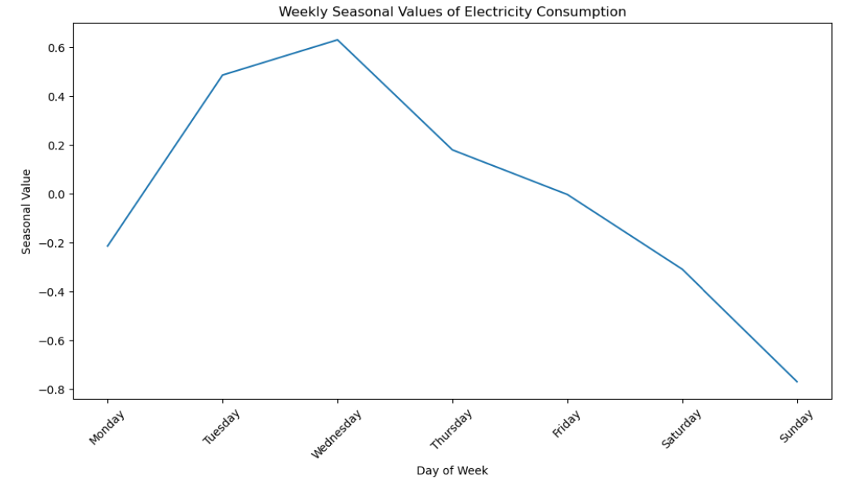
Weekly Seasonal Values
Notes:
The seasonal Values show a peak during the working week with drops on Saturdays and Sundays. This might suggest that it represents some workplace where the weekends have a much smaller number of people that are working and therefore the amount of electricity that is used is going to be much smaller. Where as during the week the electricity is higher. Which makes a lot of sense.

Slide 6
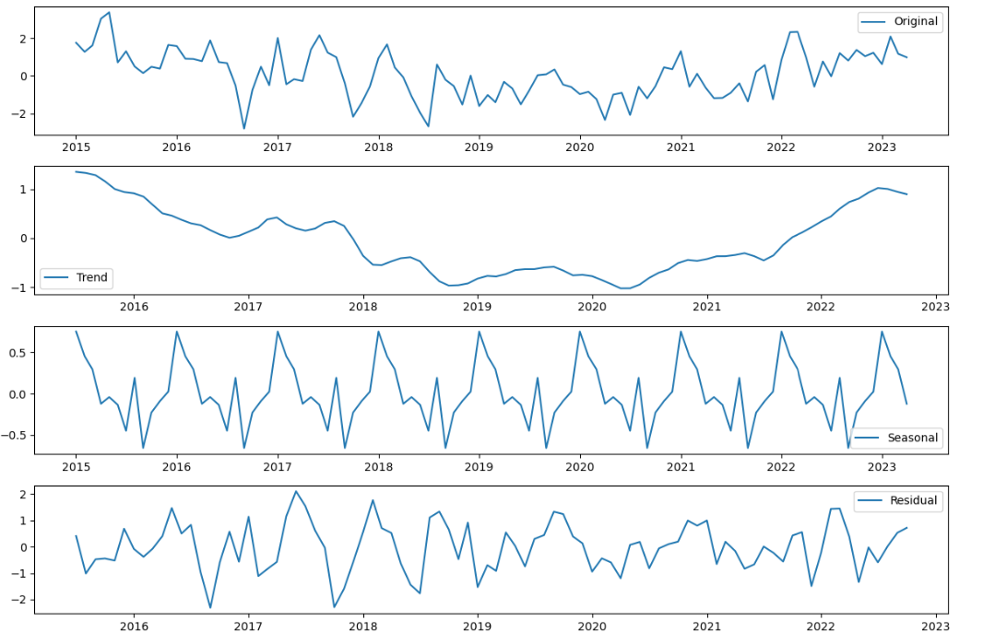
Monthly Seasonality Decomposition
Notes:
Monthly interval - This shows less of a consistent seasonal pattern and has spikes and dips. This would not reflect what would be expected when looking at monthly electricity consumption as it is assumed that there is a strong correlation with weather which changes more smoothly.
Trend - There is no overall change in the average values in the time series.
Cycle - There is a cycle that takes place where there is a drop from 2018 to 2021 before 2022 and 2023 returns to values similar to 2016. This does not make a while lot of sense because it is assumed that the amount of electricity that was used during 2020 and 2021 would be far higher due to the Covid-19 Pandemic which took place due to the number of people that had to stay inside.
Seasonality - This seasonality does not follow as clear of a gradual change as it did with the weekly values
Residual - The residual values also seem to be larger

Slide 7
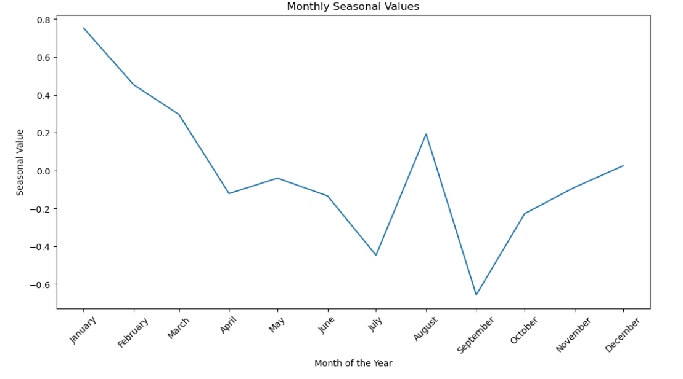
Monthly Seasonal Values
Notes:
Using months as the seasonal value it shows that January is the peak with decreasing values to July until a sudden spike up in August before leveling out in October through December.
This does not follow as clear of a pattern as it does with the weekly seasonal values.

Slide 8
Mean Absolute Error for Weekly vs. Monthly
MAE Weekly = 0.5925758047097736
MAE Monthly = 0.7489559703540682
Notes:
The MAE will give you the average distance that the residuals are from the line of zero. The most accurate seasonal decomposition has residuals of 0, so the residual with the smallest mean absolute error is going to reflect a more accurate depiction of the movement of the data. Comparing the weekly and the monthly should also give better insight into which is better to use for the time interval.
Weekly electricity is going to be the correct interval that is used for the time series due to the behavior of the seasonality, understanding of real world events, and the lower MAE.

Slide 9
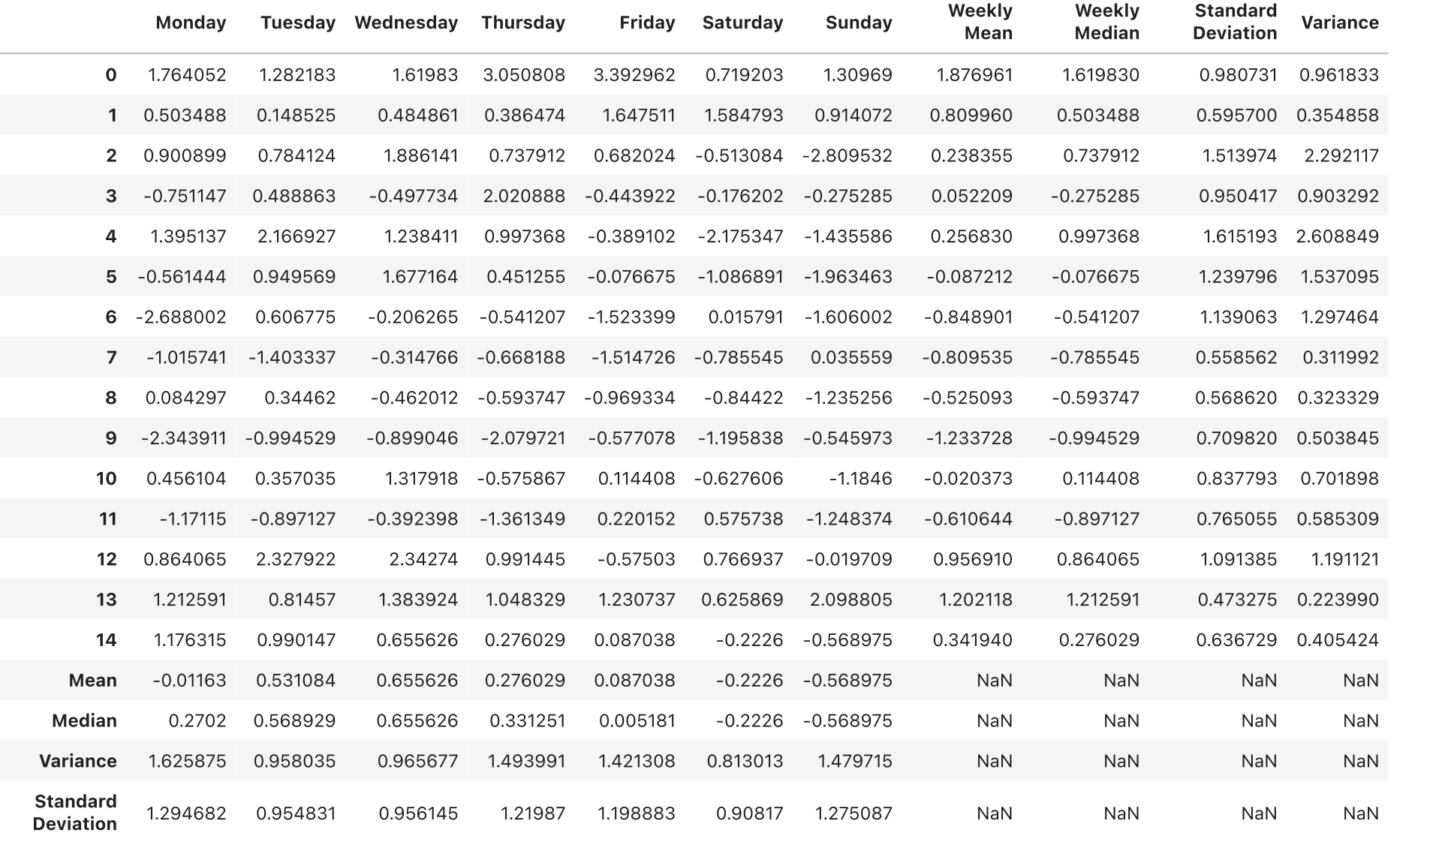
Preliminary Analysis
Notes:
Here we have a table of Preliminary Analysis: From this table we were able to make a weekly charts for Mean, Median, Variance and Standard Deviation.

Slide 10
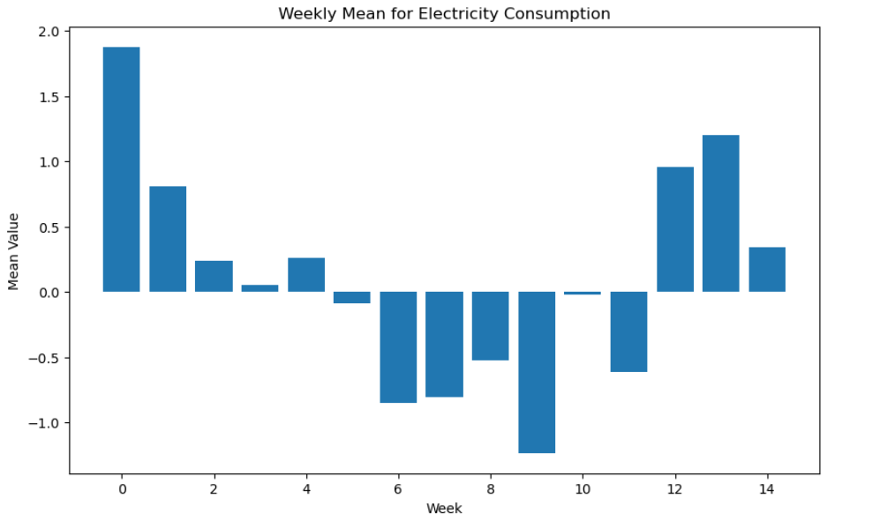
Weekly Mean
Notes:
In this chart we can see a clear pattern, that is similar to trend that is observed for the trend of electricity consumption data. Closer to summer months there are decrease in the amount of electricity used. This has to be due to the less use of AC due to the hotter temperature outside.

Slide 11
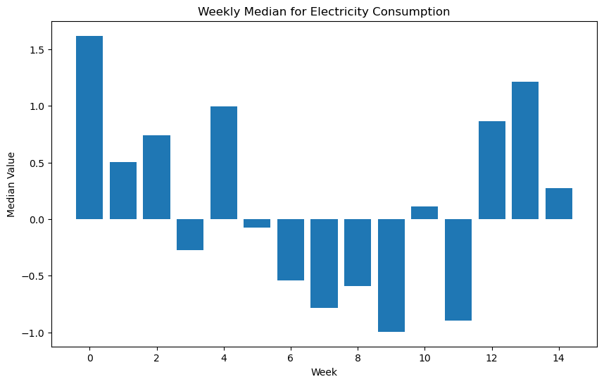
Weekly Median
Notes:
Median seem to follow a similar trend where the initial and end of the data months is positive while the middle is negative. However, it is worth to note that there are certain weeks which have far different mean values vs median. Such as week 4 which has a much higher median than the mean, it implies that the variance is higher.

Slide 12
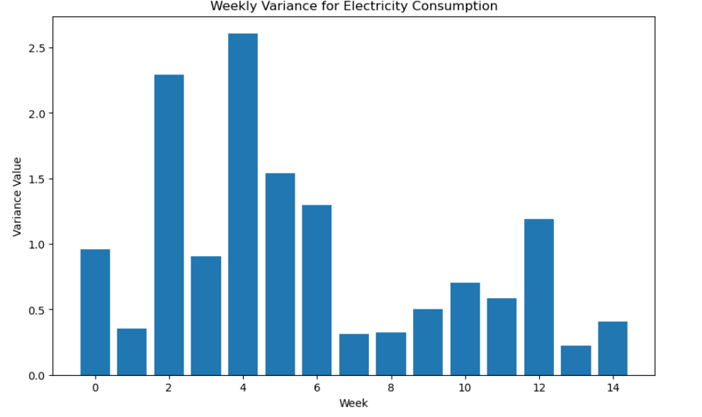
Weekly Variance
Notes:
This slide focuses on weekly variance in electricity consumption, highlighting the fluctuation range around the average. High variance suggests significant weekly consumption differences, while low variance indicates stability. This metric is crucial for forecasting accuracy, energy planning, and managing peak demand periods, informing both model selection and energy supply strategies.

Slide 13
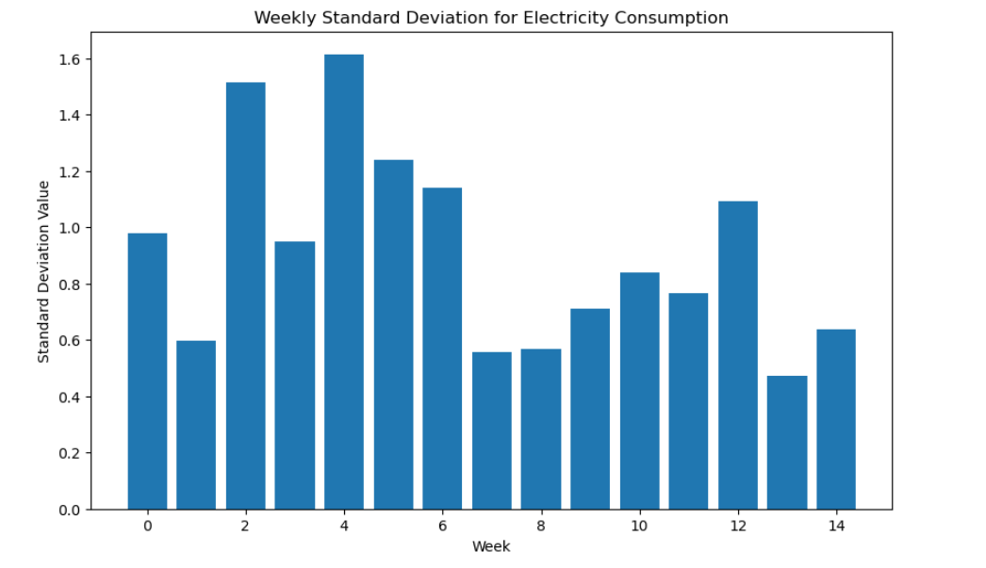
Weekly Standard Deviation
Notes:
This slide explores the weekly standard deviation of electricity consumption, reflecting the variability in weekly usage. A larger standard deviation points to greater fluctuations, signaling varied consumption patterns. Conversely, a smaller value denotes more consistent usage.

Slide 14
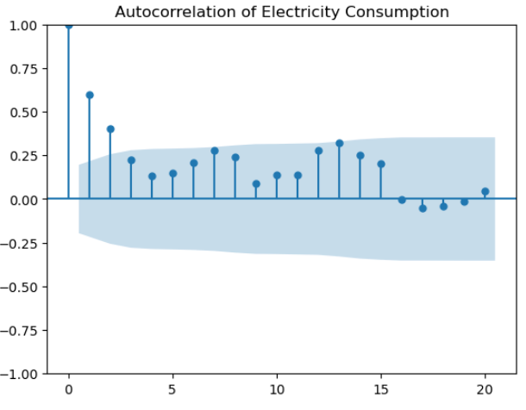
Autocorrelation with Seasonality
q = [1,2,7,13]
Notes:
This slide delves into the seasonal autocorrelation of electricity consumption, indicating how past seasonal patterns impact current usage. Significant autocorrelations highlight the influence of past consumption on present levels, crucial for accurately modeling and forecasting energy demand.

Slide 15
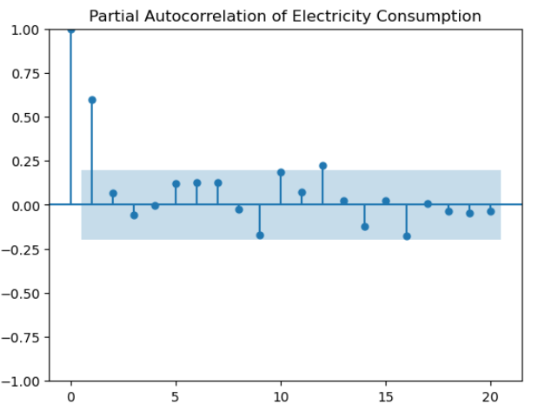
Partial Autocorrleation with Seasonality
p = [1,9,11]
Notes:
This slide presents the findings on seasonal partial autocorrelation, identifying specific lags with significant influence on current electricity consumption. These values came out to be 1,9 and 11. It’s key for determining the autoregressive terms in the creation of different box jenkins models.

Slide 16
Differencing with Seasonality (ADF Test)
ADF Statistic: -4.978224856580164
P-Value: 2.450404893865566e-05
Critical Value:
1%: -3.50
5%: -2.89
10%: -2.58
Notes:
This slide outlines the results of the Augmented Dickey-Fuller (ADF) test after applying seasonal differencing to the electricity consumption data, confirming the data’s stationarity. The significant ADF statistic and low p-value indicate successful removal of seasonality, a critical step for accurate seasonal forecasting. This validation supports the use of advanced seasonal models for precise energy demand predictions.

Slide 17
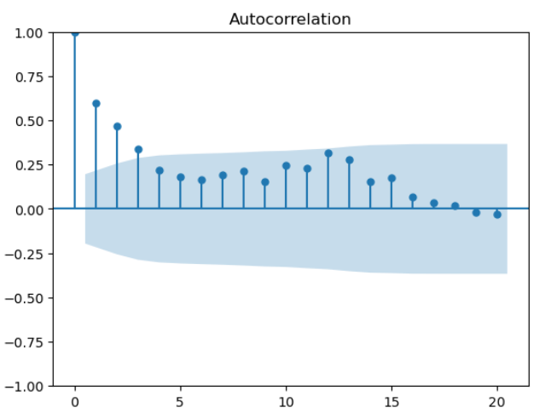
Seasonally Adjusted Autocorrelation
Q = [1,2,3,12,13]
Notes:
This slide discusses the analysis of seasonally adjusted autocorrelation, showing how electricity consumption correlates with its past values after removing seasonal effects. Significant autocorrelations guide the integration and moving average components of our models, crucial for capturing inherent trends and improving forecast precision. This step enhances model reliability for effective energy usage prediction.

Slide 18
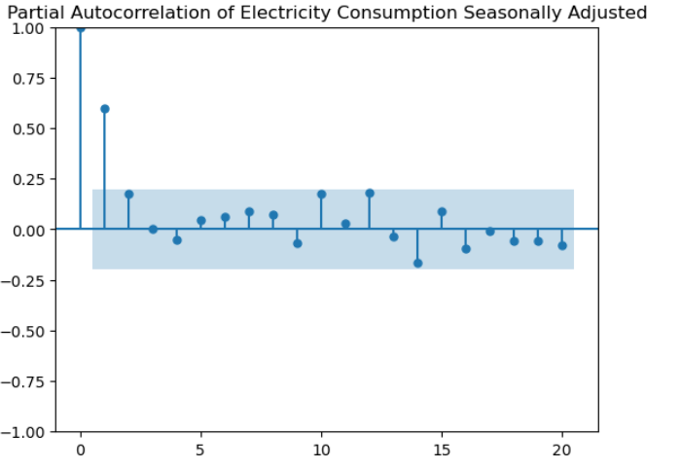
Seasonally Adjusted Partial Autocorrelation
P= [1,2,10,12,14]
Notes:
This slide reveals the analysis of seasonally adjusted partial autocorrelation, pinpointing significant lag impacts on current electricity consumption. These findings guide the specification of autoregressive terms in our models, refining their ability to capture past consumption's influence while adjusting for seasonality.

Slide 19
Differencing without Seasonality (ADF Test)
ADF Statistic: -3.6626097320270086
P-Value: 0.00467090061942871
Critical Value:
1%: -3.50
5%: -2.89
10%: -2.58
Notes:
This slide presents the results of the Augmented Dickey-Fuller (ADF) test after applying differencing to remove seasonality from electricity consumption data. The significant ADF statistic and low p-value confirm data stationarity, crucial for reliable time series analysis. This step validates our approach and ensures accurate modeling for precise energy demand forecasts.

Slide 20
Model Selection: AR, MA, ARMA
AR:
Best “AIC”: 289.08,
Best “AIC” model’: 1
Best “BIC”: 296.89
Best “BIC” model: 1
MA:
Best “AIC”: 294.64,
Best “AIC” model’: 2
Best “BIC”: 305.06
Best “BIC” model: 2
ARMA:
Best “AIC”: 284.58,
Best “AIC” model’: (11,1)
Best “BIC”: 303.95
Best “BIC” model: (1,1)
Notes:
This slide compares the effectiveness of Autoregressive (AR), Moving Average (MA), and combined ARMA models in capturing electricity consumption patterns. The chosen model, ARMA, exhibits the best fit, balancing complexity and accuracy based on AIC and BIC criteria. Overall, the AIC appears to be lower than the BIC throughout.

Slide 21
ARIMA Model Selection
Best AIC: 285.5966269362885
1
Best AIC Model:
(1, 1, 1)
2
Best BIC: 293.38198648669226
3
Best Bic Model:
(1, 1, 1)
4
Notes:
This slide highlights the selection process for the ARIMA model, focusing on minimizing the Akaike Information Criterion (AIC) and Bayesian Information Criterion (BIC). The chosen ARIMA configuration (1,1,1) strikes a balance between complexity and fit, ensuring accurate electricity consumption forecasts. This model selection optimizes predictive capability, crucial for effective energy management strategies.

Slide 22
SARIMA:
Best AIC: 281.09
Best BIC: 291.18
Best PDQ:
(1, 1, 1),
Seasonal PDQs:
(0, 1, 1, 7)
Notes:
This slide emphasizes the selection of the Seasonal Autoregressive Integrated Moving Average (SARIMA) model. The chosen SARIMA configuration demonstrates superior forecasting accuracy based on AIC and BIC metrics. This model's precision in capturing seasonal patterns ensures reliable electricity consumption predictions, essential for informed energy planning and management.

Slide 23
Conclusion
Electricity Consumption Trends
Analysis revealed upward trend in electricity consumption over time
Seasonal Patterns
Significant weekly seasonality
Higher during weekends and the colder months
Stationarity and Forecasting
After differencing, electricity consumption became stationary, enabling forecasting
Model Selection and Accuracy
Selection of SARIMA model based on the lowest AIC and BIC proved to be accurate in forecasting
Impact of External Factors
Economic indicators, weather conditions, electricity consumption trends
Implications for Energy Management
Important to integrate seasonal patterns and external factors into energy planning
Notes:
Concluding our analysis, we highlight the upward trend in electricity consumption and the discernible weekly and seasonal patterns. With future predictions, we could look at the impacts of economic indicators, weather conditions, electricity consumption trends. Overall, the selected SARIMA model stands out for its forecasting accuracy, providing valuable insights for sustainable energy utilization.

